Slide 1
Accelerated Reader
Reading Scheme

Slide 2
‘’Reading is important. If you know how to read then the whole world opens up to you.’’

Slide 3
What is Accelerated Reader?
Accelerated Reader is a computer based reading scheme that helps to monitor and progress children with their reading.
It helps to identify children’s strengths and areas for improvement.
Provides details of a child’s reading level and the most appropriate book level (ZPD) to enable progress in reading.
Accelerated Reader is for KS2 children. There will be a cross over into the scheme some point from Year 2 onwards.

Slide 4
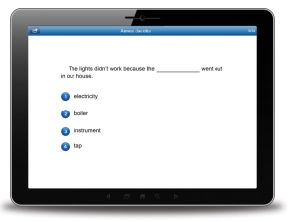
Star Reading
20 minute computer-adaptive test used to assess reading ability.
Tracks reading growth
Provides children with a personalised reading age called the ZPD (Zone of Proximal Development).
Tests a wide range of reading skills that progressively get more advanced with each correct answer given.
Completed each half-term to track progress and provide new reading levels.

Slide 5
Reading is not just…. Reading!
The obtained results showed that MRSA was able to grow in rocket extract. In addition, proteome analysis using 2-DE method showed that MRSA strain COL is taking advantage of the sugar-, lipid-, and vitamin-rich substrate in the liquid rocket extract, although its growth was delayed in rocket extract compared to Luria– Bertani medium. This work could initiate further research about bacterial metabolism in plant-based media and defense mechanisms against plant-derived antibacterials.

Slide 7
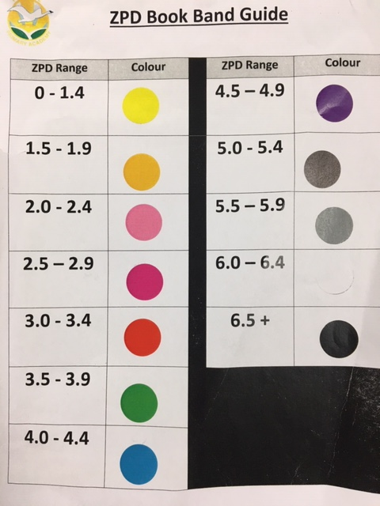

Slide 8
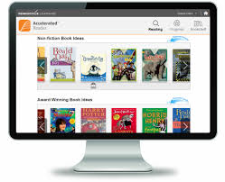
Accelerated Reader Book Quizzes
After reading a book, children will then take a quiz online based on that book they have just read. These will be completed at school.
This is normally around 10 questions.
It will test that the child has FULLY understood the book, being able to have a deeper understanding of the text.
Instant results for the child with then recommended books to choose next.
Children will read and quiz on as many books as possible until the next Star Reader test.
A child will read within their ZPD range for the duration of that half-term.

Slide 9
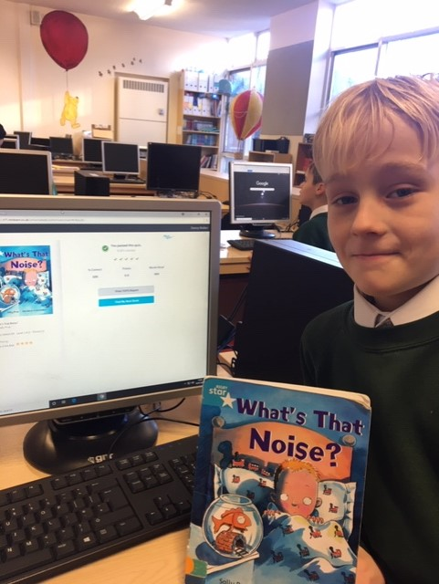
Loyalty Card
We will be encouraging children to read with their own
‘Reading Card’. Children who achieve 80% or more on their book quiz will be able to get a stamp on their card which leads to some very exciting incentives!
This is to encourage deep understanding of the books and not just children rushing through a book without taking their time to fully understand the text they are reading.

Slide 10
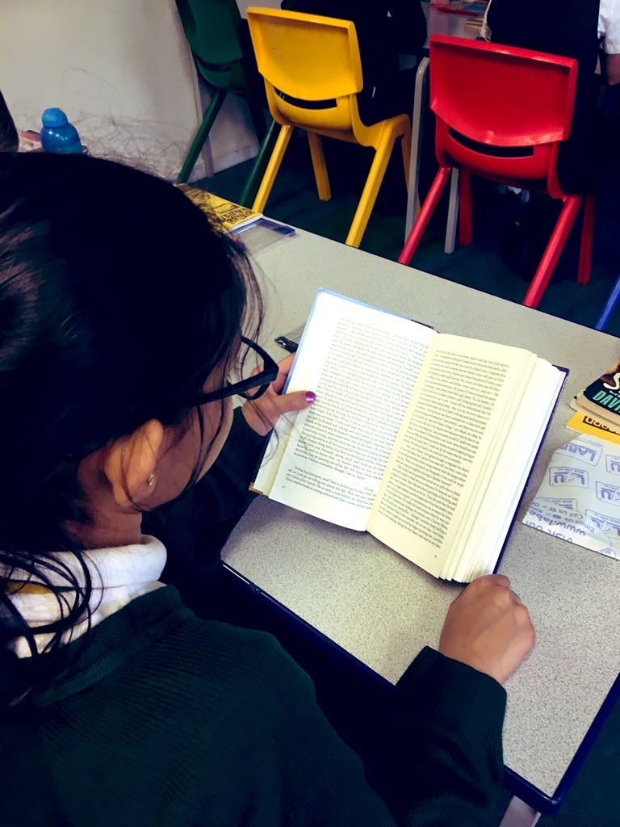
Structure of the Scheme
Children MUST bring in their school reading book daily alongside their reading records.
Children have Reading 4 Pleasure (R4P) sessions at school and may have the opportunity to read to a member of staff or the many volunteers we get in who read with the children.
We encourage children to take home their school book to do further reading at home.
Alongside this, we encourage the children to read anything that they enjoy at home!

Slide 11
What can you do to help your child succeed?
We would expect that children read for at least 20 minutes everyday (In the UKS2 years we expect this to be 30 minutes daily)
Share the reading experience with your child.
Ask questions ( e.g. What do you think is going to happen next?)
Be a part of the book choosing process.

Slide 13
AR Book Finder
You can use the website www.arbookfind.co.uk to search books that are within your child’s ZPD range.
Go out and buy books.
Go to a local library.
Your child can still test on these books if they are within their ZPD level.
Make sure it’s a book they are excited about!

Slide 14
Common Questions
My child’s book looks too easy for them. Is this the right level of book for them?
How can I stretch my child even further?
Is the school colour band system the same as last year?
How often will my child’s book be changed?
My child is not scoring

Slide 15
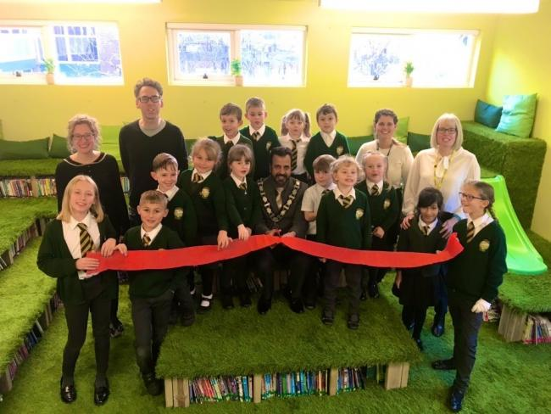
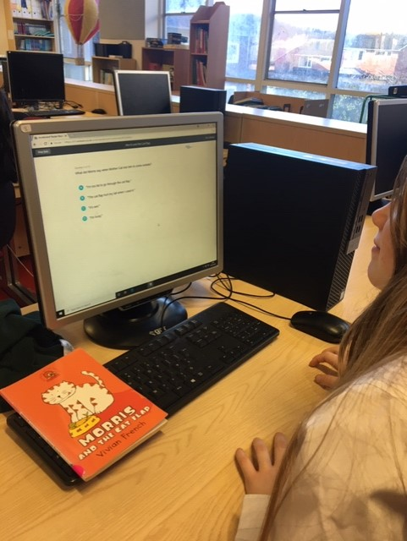
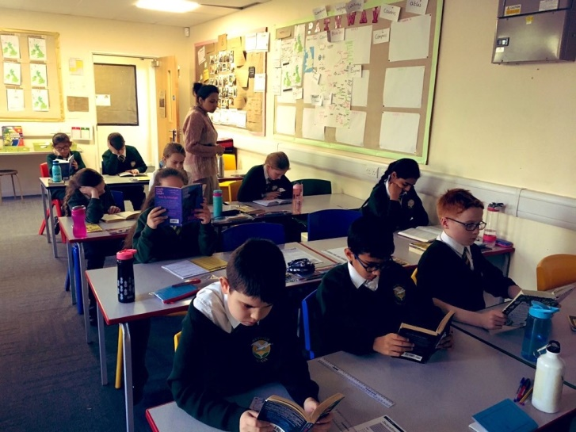
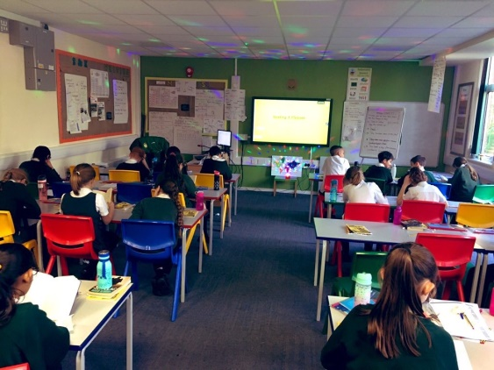
What have we done so far?
All children have completed their 1st Star Reader test and have been given their ZPD level and book band.
Children are now beginning to quiz on their books.
We have a very exciting new library that has created a reading buzz through the school!
We are soon going to be introducing a word count chart game where classes will be in competition with each other.

Slide 16
Thank you for listening.
Any questions?

